Slide 1
Each of Us is a Character in the Stories Told Around the Dinner Table
The Power and Value of Storytelling

Slide 2
What is a story?
A story is a narrative about people and events, or an account of people or events, imagined or real. (Vocabulary.com)
Most storytellers have a purpose behind telling a story - to entertain, to prove a point, to retell an event they experienced or witnessed, etc.
All stories are told through the perspective and bias of the narrator

Slide 3
Stories told about your school matter
Appointed principal at Lone Peak High School in the spring of 2021
An interesting thing happened when I would meet people.

Slide 4
How are you and your staff members portrayed in the stories your students tell about your school?
I am the father of five children
I have heard many stories told around our dinner table (or, in the car, or on a walk, or while playing board games, etc.)

Slide 5
What is the feeling created through interaction
Nearly every story told about you or your school comes down to a feeling an individual is left with.

Slide 6
You cannot control the stories people tell, BUT you can influence the feeling that people are left with as they interact with you.
Be kind
Be fair
Be active
Be honest
Show grace

Slide 7
Engage in storytelling - where is your voice in this?
We started to weekly video messages - Admin messages - and we rotate through our admin team.
It doesn't have to be this same format. You can do this through a social media presence, a Canvas announcement, etc.

Slide 8
Storytelling
I started a podcast
“The Lone Peak ToddCast”
“To connect the school with the home and the community, and to insert our own voice into the story being told about Lone Peak.”

Slide 9
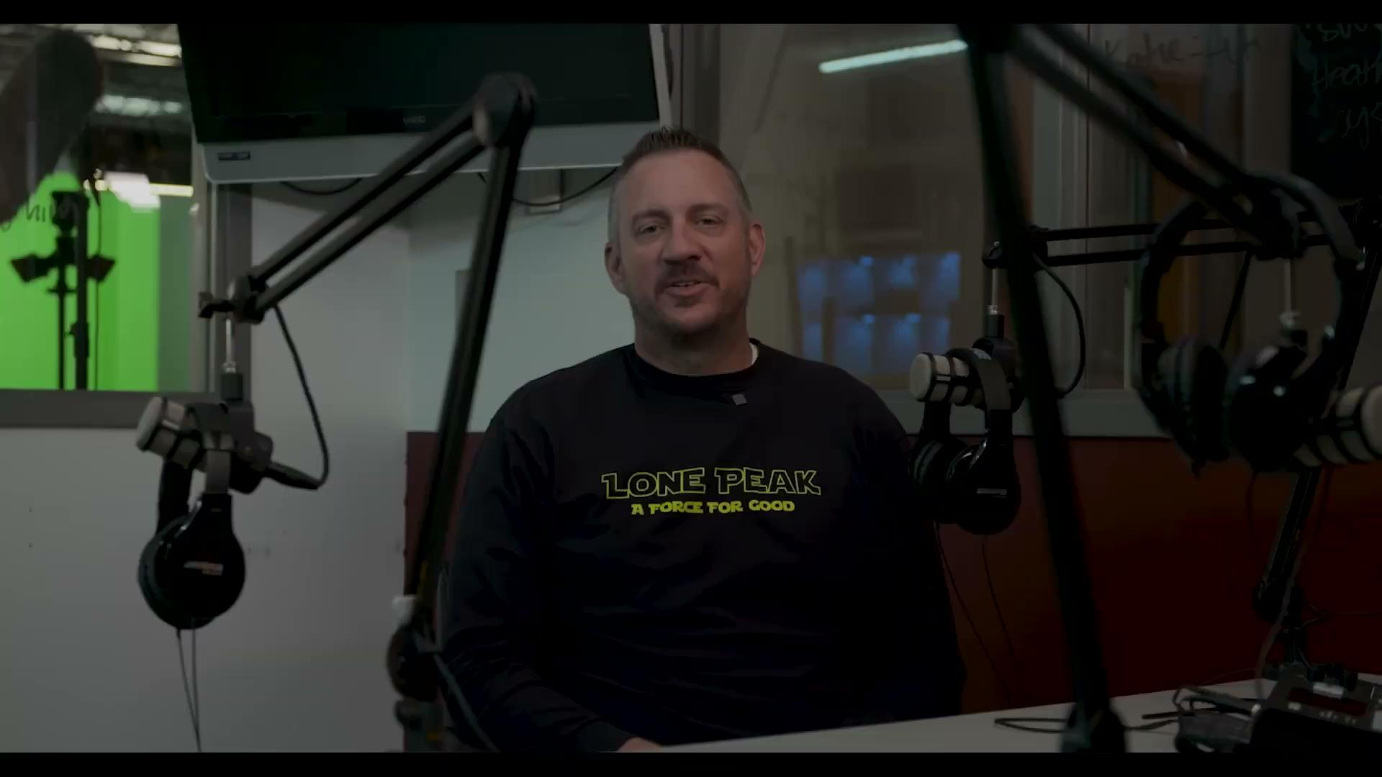
Storytelling

Slide 10
So What?
Know that there are always stories are being told!!
Drivers Ed teacher: relayed a story told to him on a morning drive
School trip - “my kid told me how much fun they had getting to know you outside of school”
Swim Meet - “We were talking about you the other day and how much we loved seeing you at our swim meet!”

Slide 11
Each of us is a character told in the stories around the dinner table!
Email from a teacher

